Slide 1

Data Analysis Specialist Track – G3 Final Project
Members:-
Ahmed Mohamed ElSayed
Hossam Mohamed Aosama
Frawla Youssef Ahmed
Manal Muhammed AbuShama
Toka Ezz Eldeen Ahmed
Suhayla Sherif ElSayed

Slide 2
Introduction
This analysis of HR data is essential for understanding workforce dynamics and optimizing human resource management. This report examines an HR dataset containing employee demographics, job roles, salaries, performance evaluations, and attrition rates. The goal is to identify key trends and patterns that impact employee retention, performance, and compensation. Insights from this analysis will support data-driven decision-making, helping to improve employee satisfaction and optimize organizational efficiency.

Slide 3
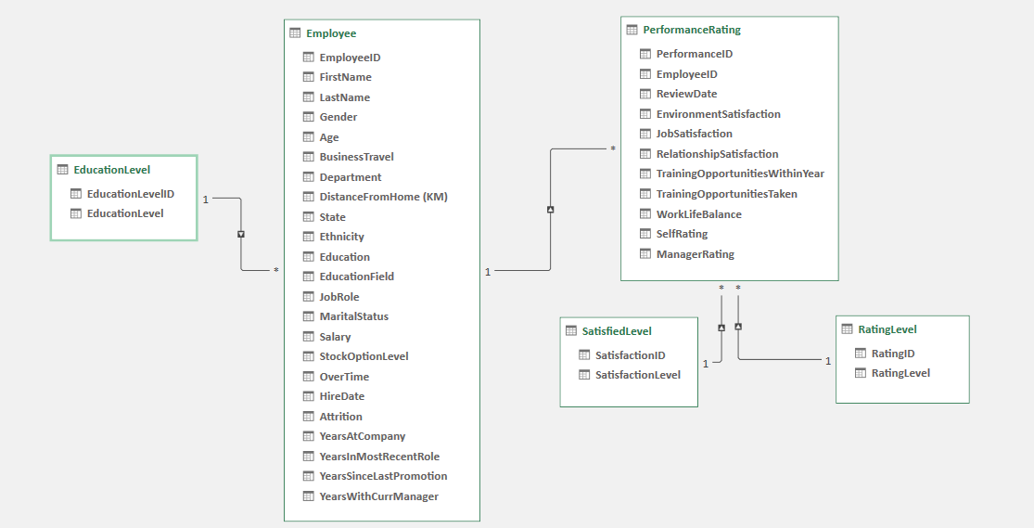
Excel: here a preview of the original dataset after we set the relations using Power Pivot

Slide 4
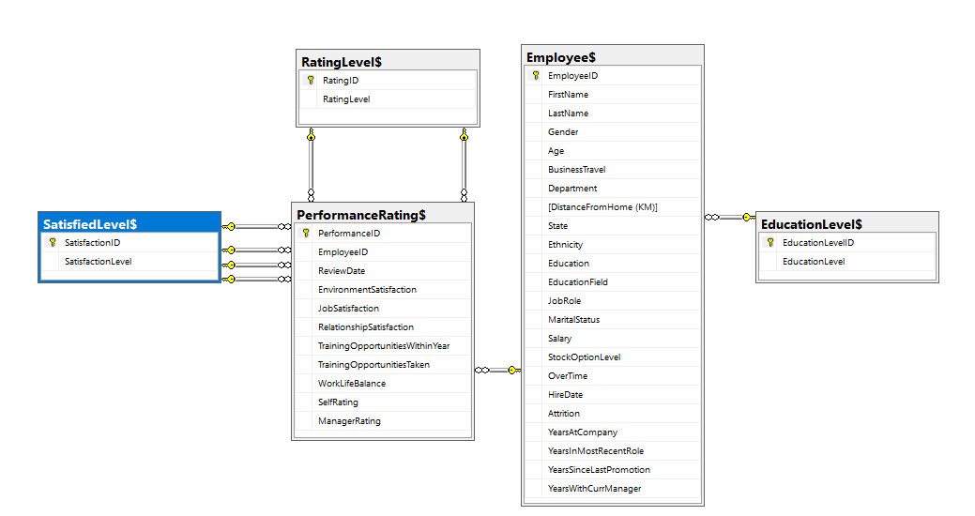
SQL ERD: this is the diagram of ERD after Importing the dataset to SQL

Slide 5
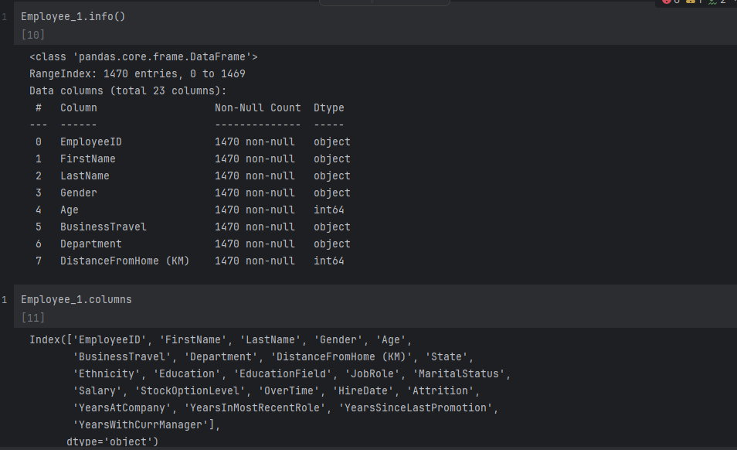
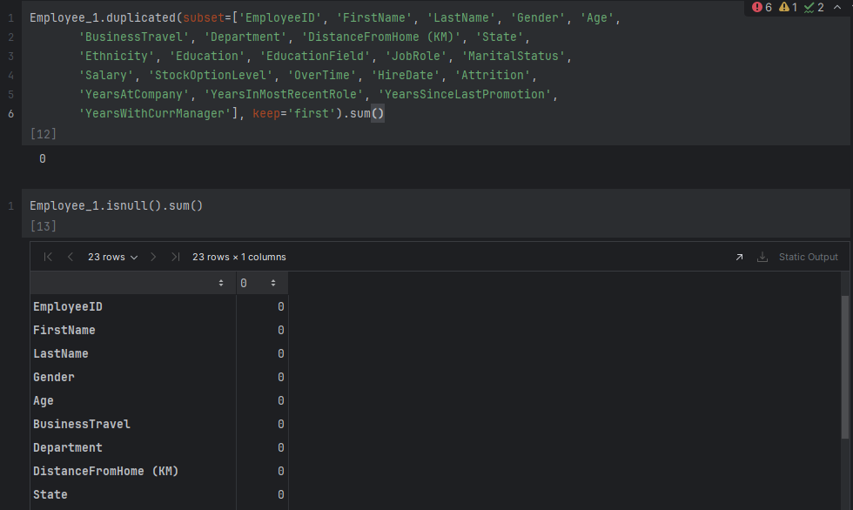
Python: we used it in data cleaning and processing and presenting some data as data table and charts

Slide 6
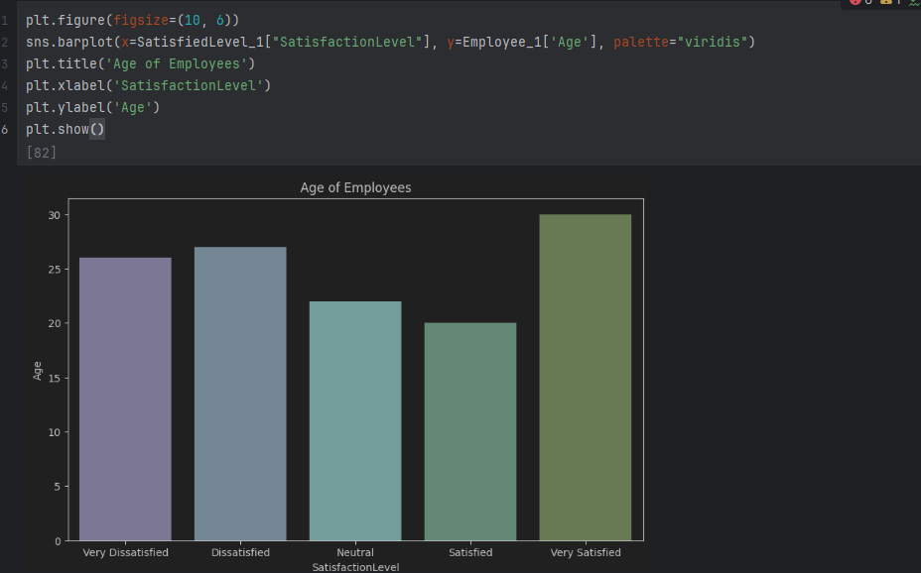
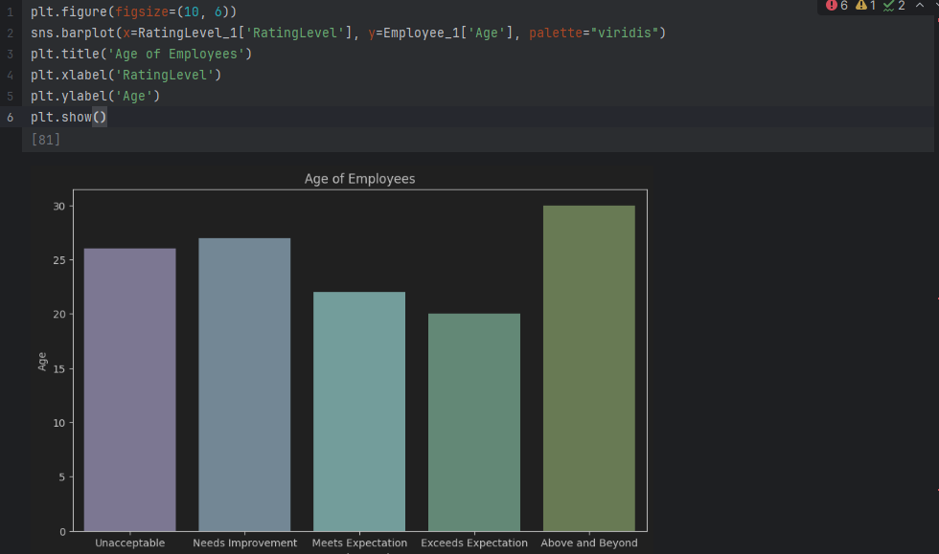

Slide 7
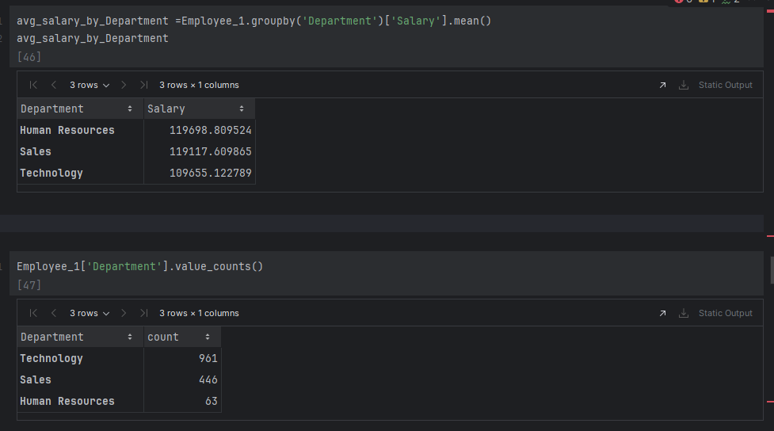
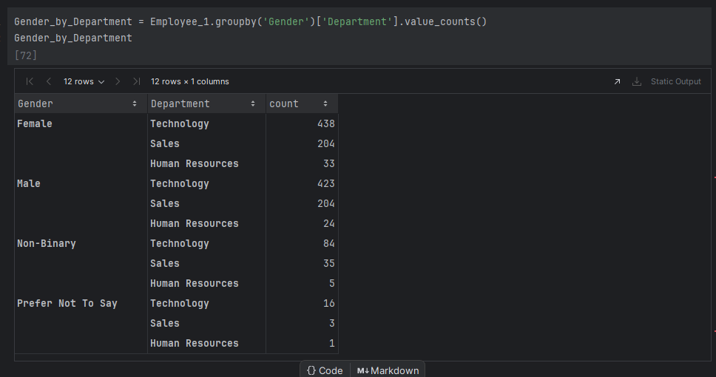

Slide 8
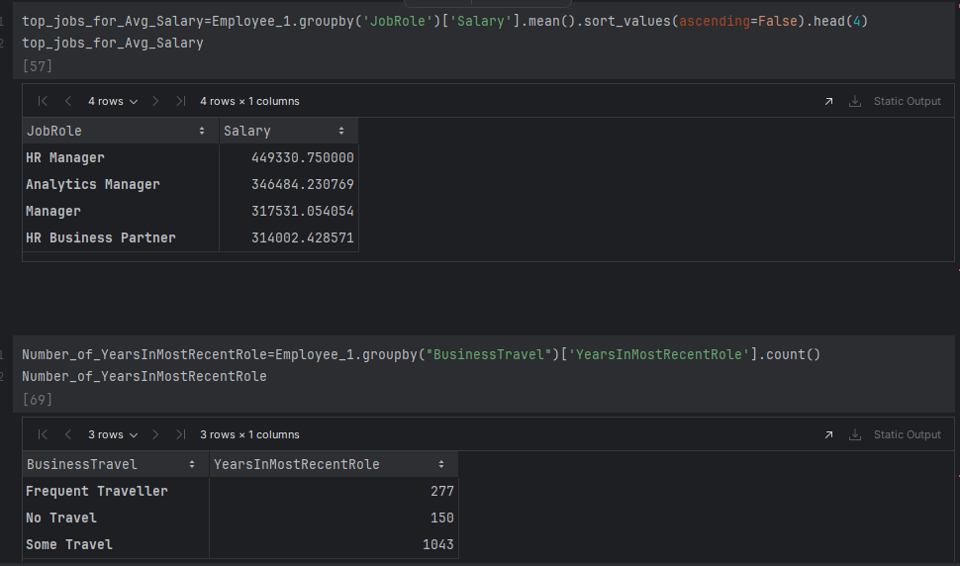
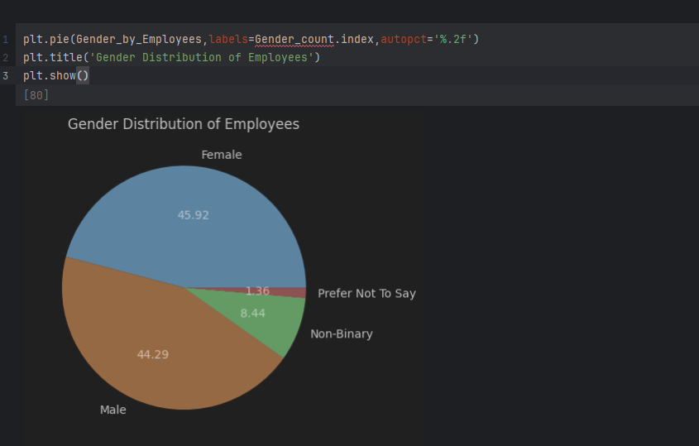

Slide 9
Part 1: Training, Satisfaction, and Performance
This part focuses on the relationships between training, employee satisfaction, and performance, diving deep into how different demographics respond to training opportunities.

Slide 10
Training's Impact on Performance

Slide 11
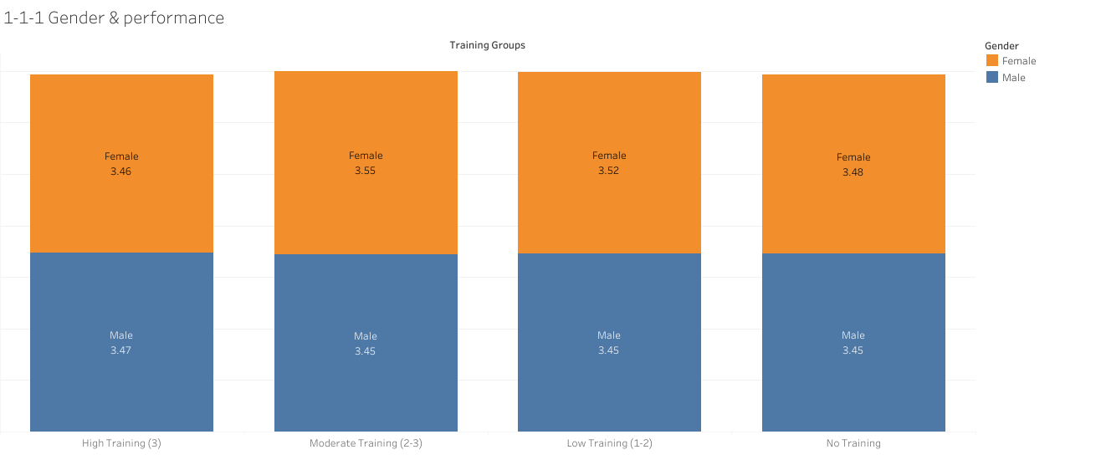
Write here

Slide 12
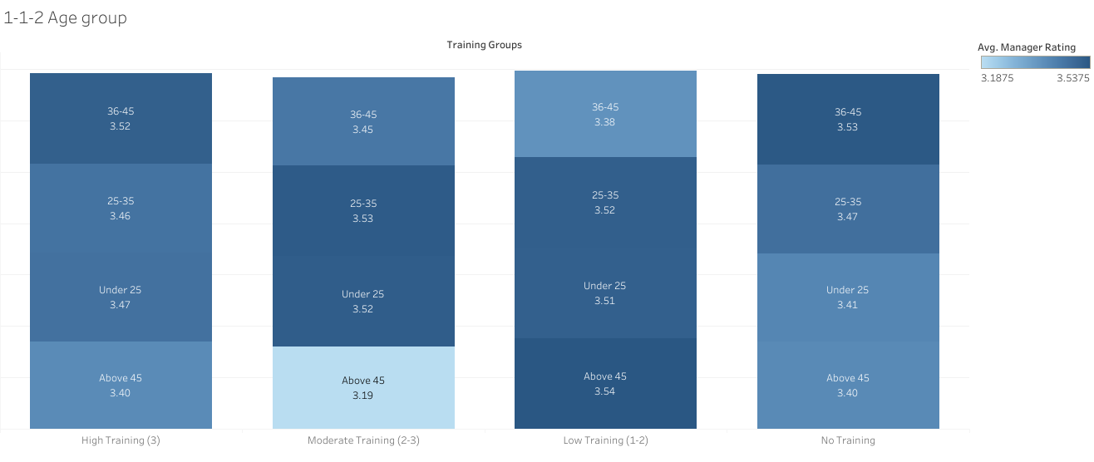
Write here

Slide 13
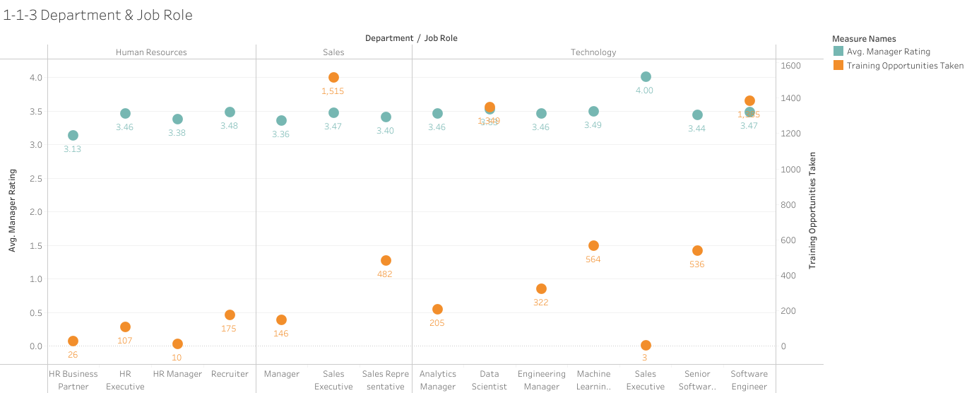
Write here

Slide 14
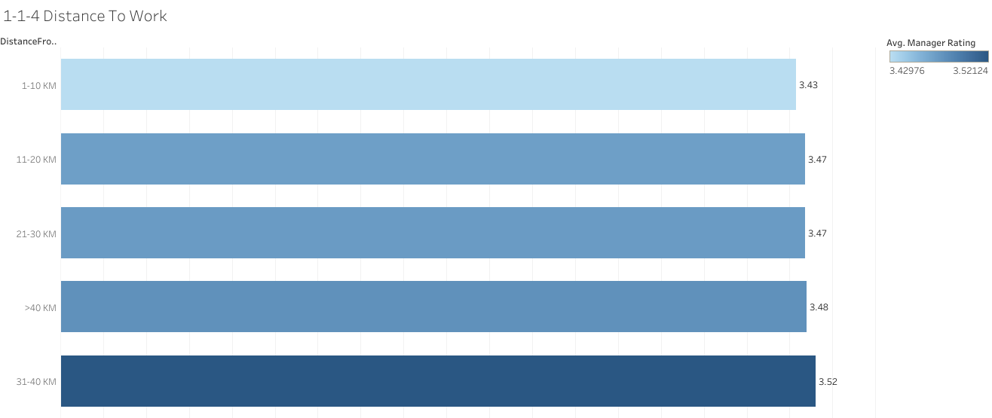
Write here

Slide 15
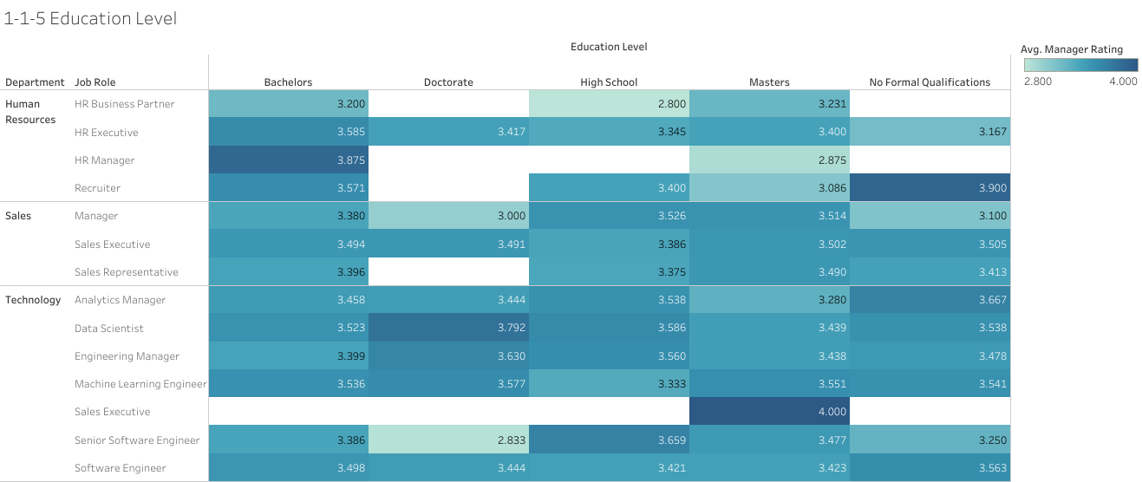
Write here

Slide 16
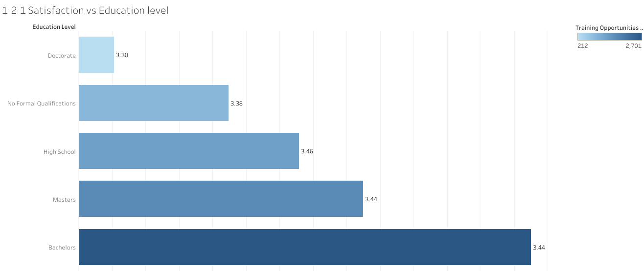
Write here

Slide 17
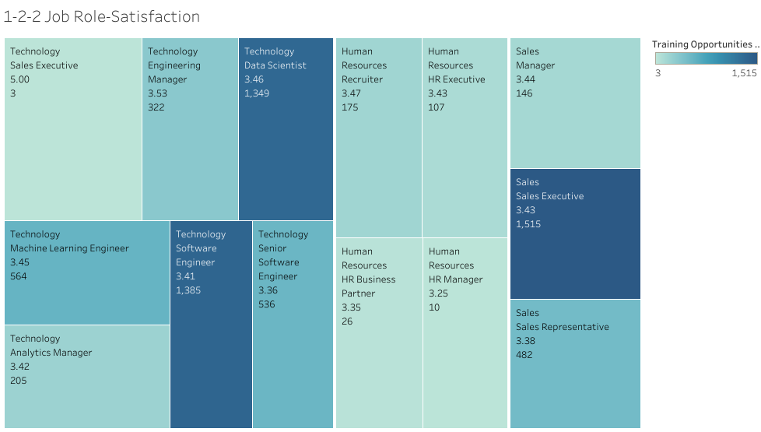
Write here

Slide 18
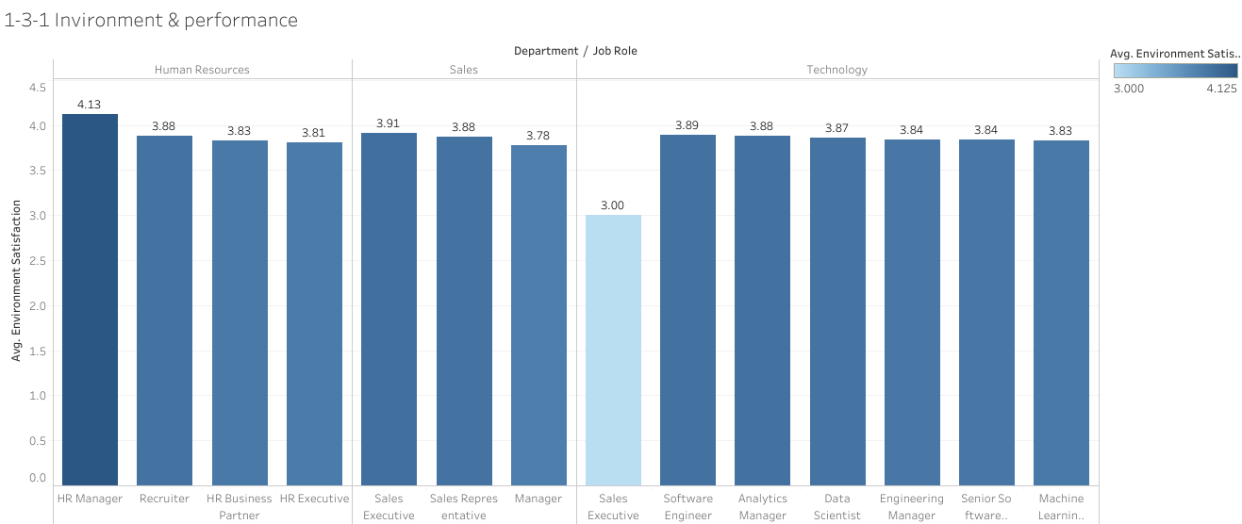
Write here

Slide 19
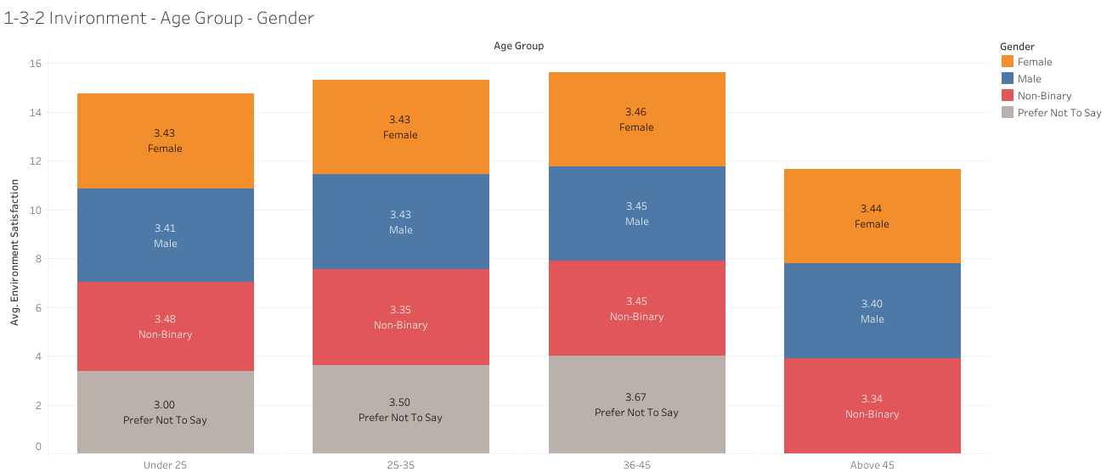
Write here

Slide 20
Job Satisfaction and Training Opportunities

Slide 21
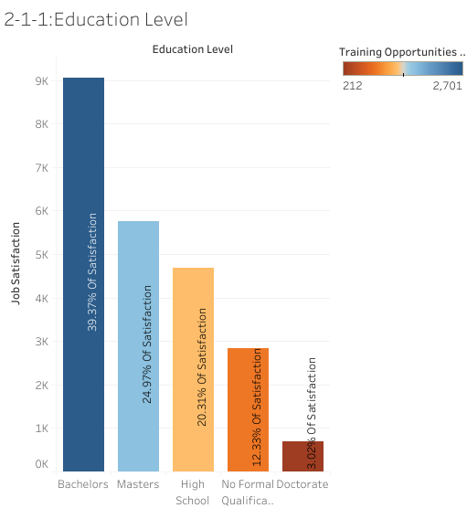
Are more highly educated employees more satisfied with training opportunities, and how does this reflect in their performance?

Slide 22
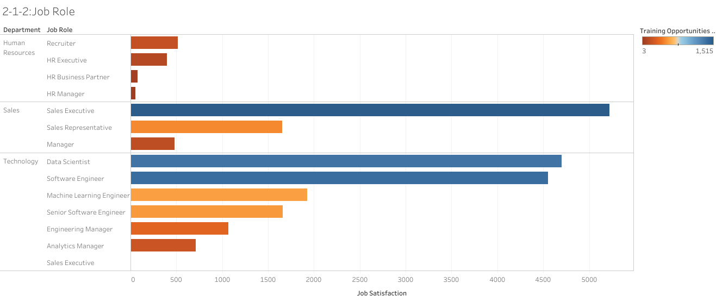
Which job roles or departments are linked to higher satisfaction post-training?

Slide 23
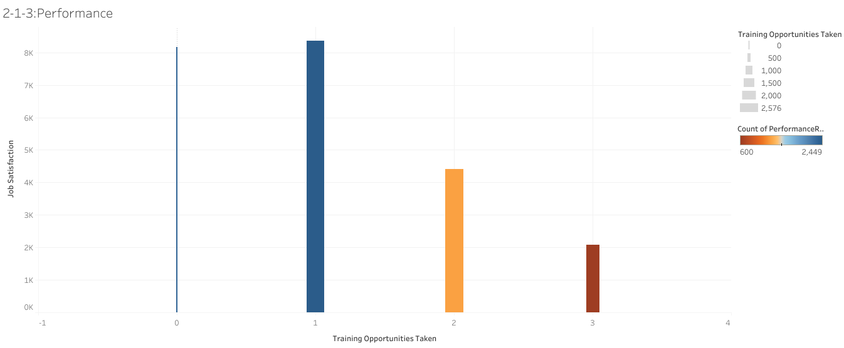
How do employees who undergo more training programs compare in terms of both Job Satisfaction and Performance?

Slide 24
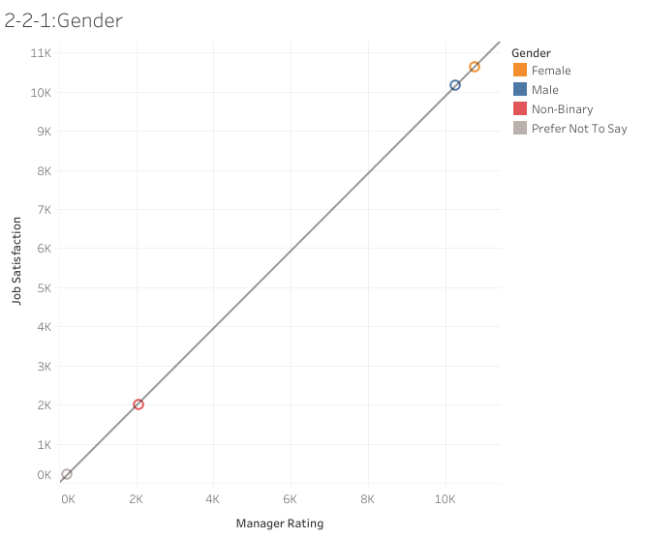
Do employees across different gender identities show stronger correlations between satisfaction and performance?

Slide 25
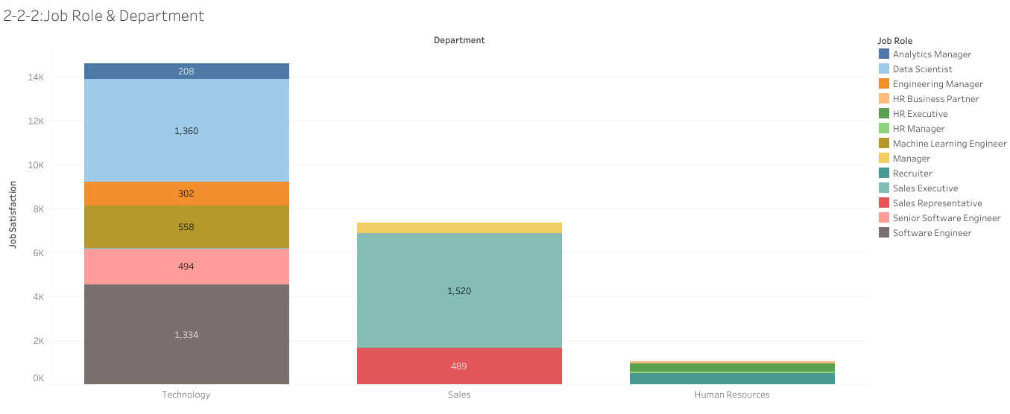
Are some departments better at maintaining both high satisfaction and high performance?

Slide 26
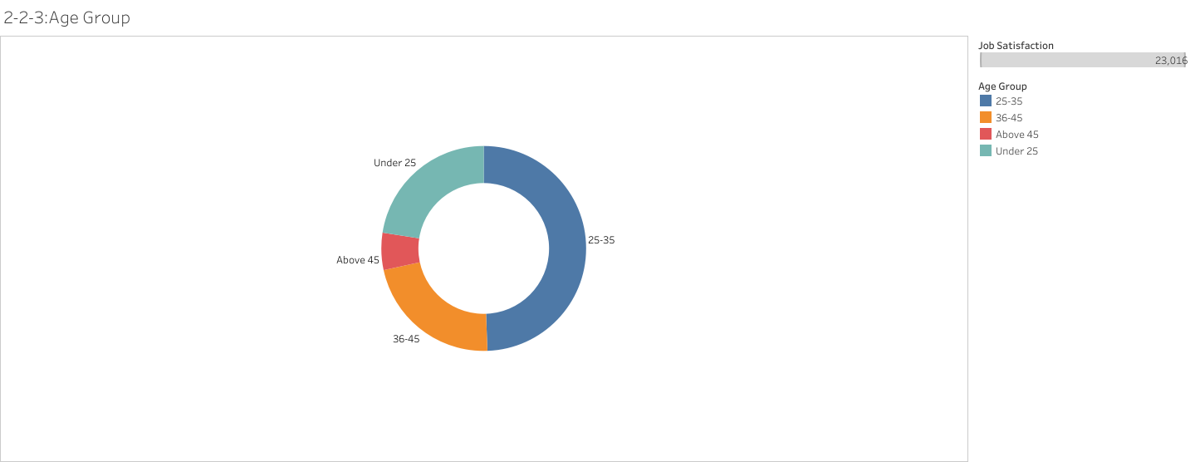
Does the relationship between satisfaction and performance vary by age group?

Slide 27
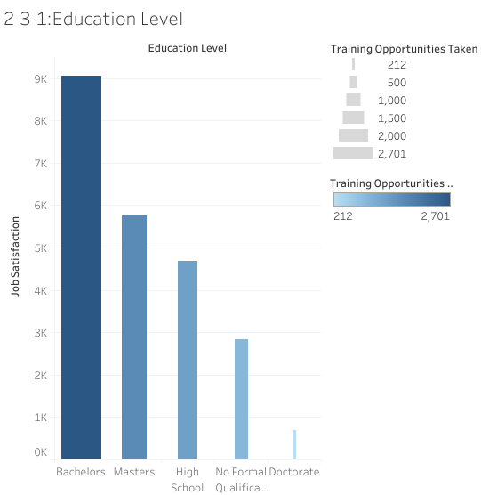
Are more highly educated employees more satisfied with training opportunities?

Slide 28
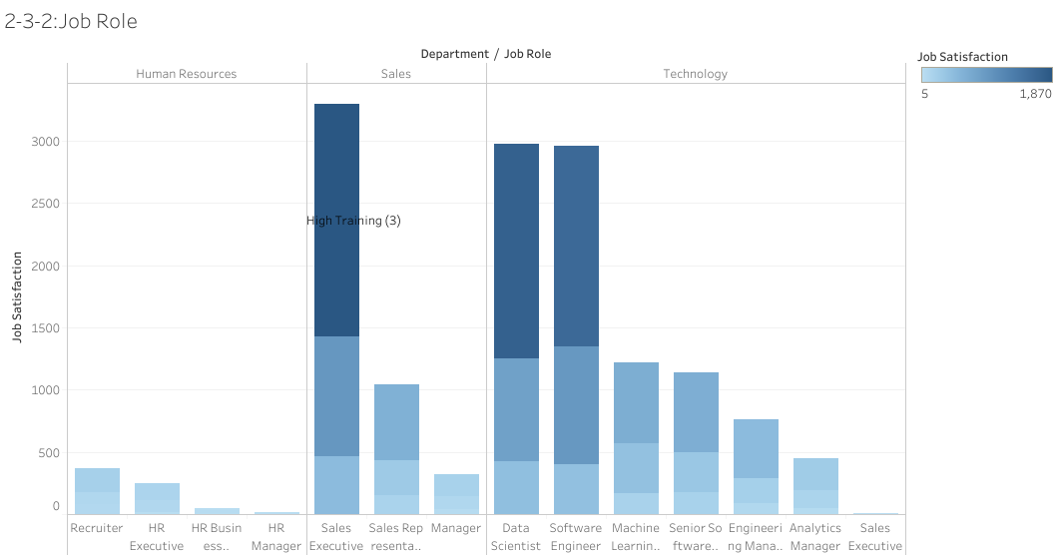
Which job roles or departments are linked to higher satisfaction post-training?

Slide 29
Part 2: Overtime, Work-Life Balance, and Attrition
This section explores how overtime and work-life balance affect employee performance, satisfaction, and retention, with a focus on demographic variations.

Slide 30
Work-Life Balance and Performance

Slide 31
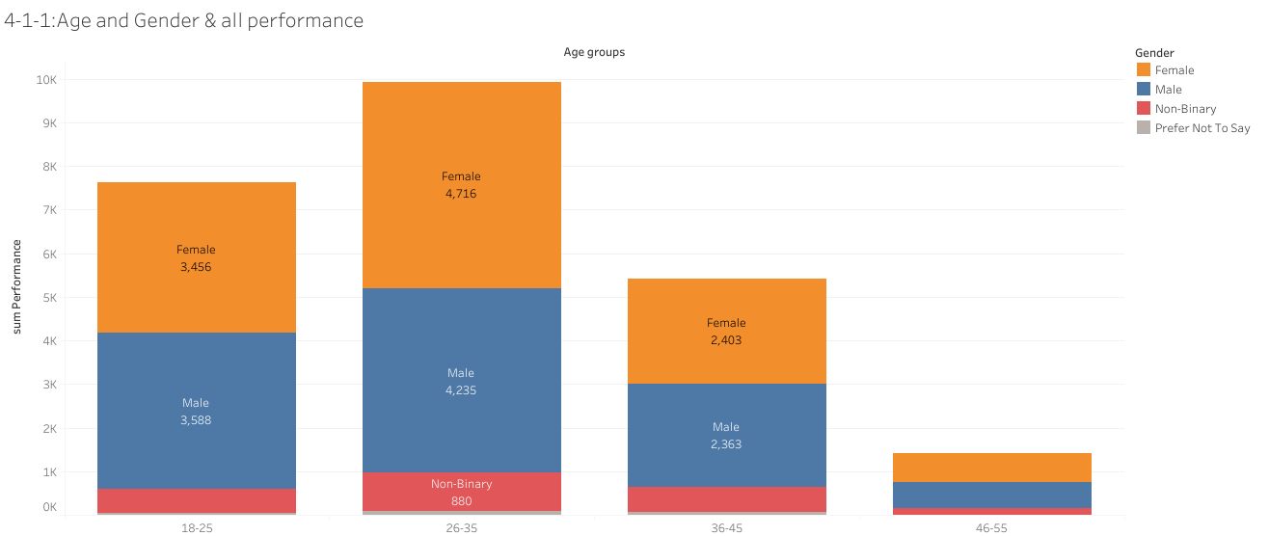
Overall Performance Ratings The older the employee, the lower the employee's performance.

Slide 32

Total Work-Life Balance Ratings The older the employee, the lower the employee's work-life balance.

Slide 33
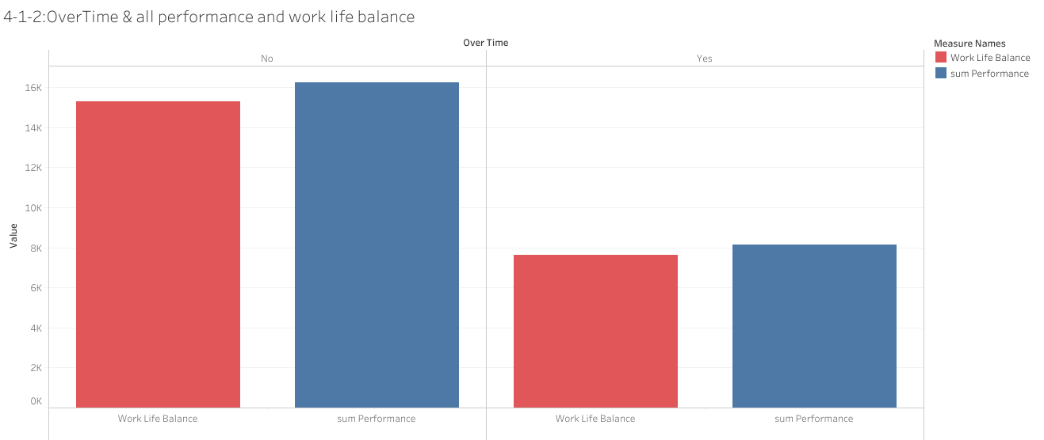
Employees who do not work overtime have better performance and greater balance in their lives, at a low rate.

Slide 34

Performance Ratings ( Self Rating , Manager Rating ) The older the employee, the lower the employee's performance.

Slide 35
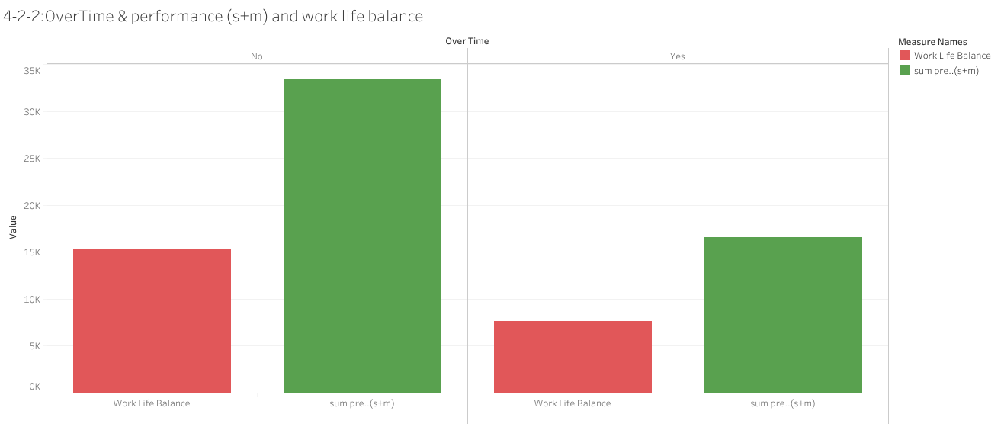
Employees who do not work overtime have better performance and greater balance in their lives, at a low rate.

Slide 36
Work-Life Balance and Attrition

Slide 37
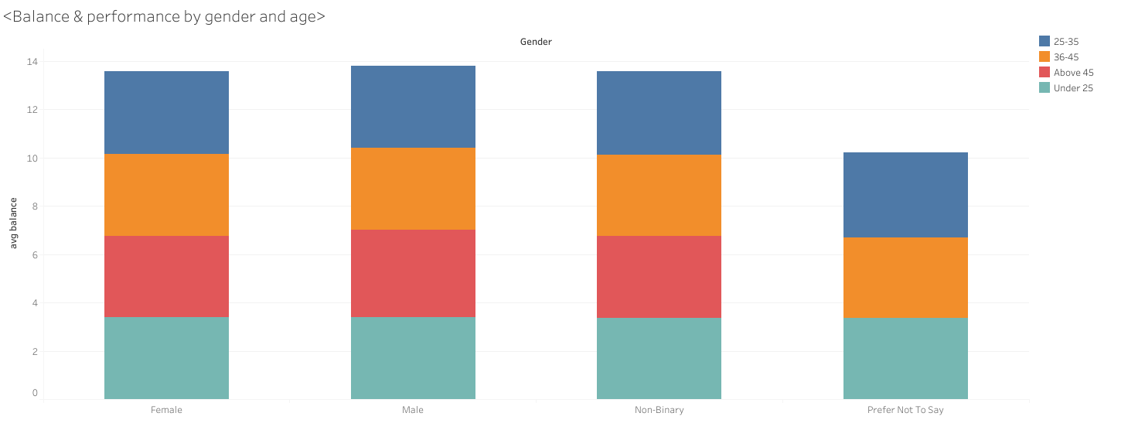
Balance & performance by gender and age .

Slide 38
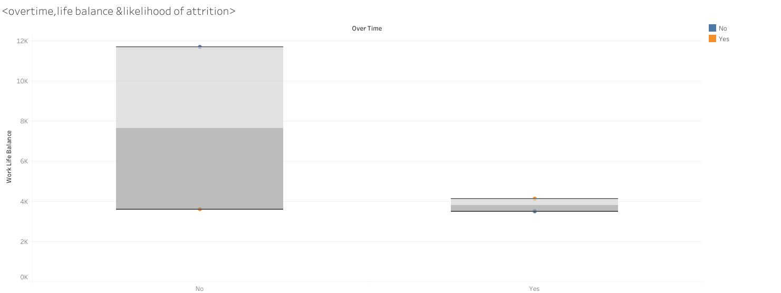
Employees who work overtime have lower work-life balance.

Slide 39
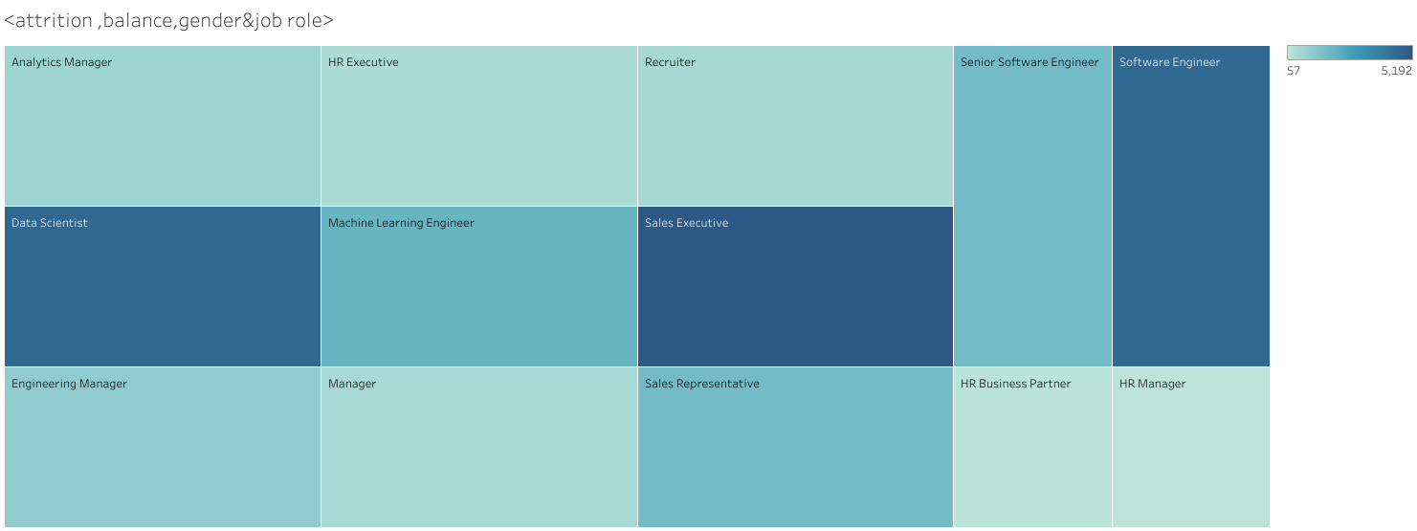
sales executive, software engineers &data scientists are of greater work-life balance.

Slide 40
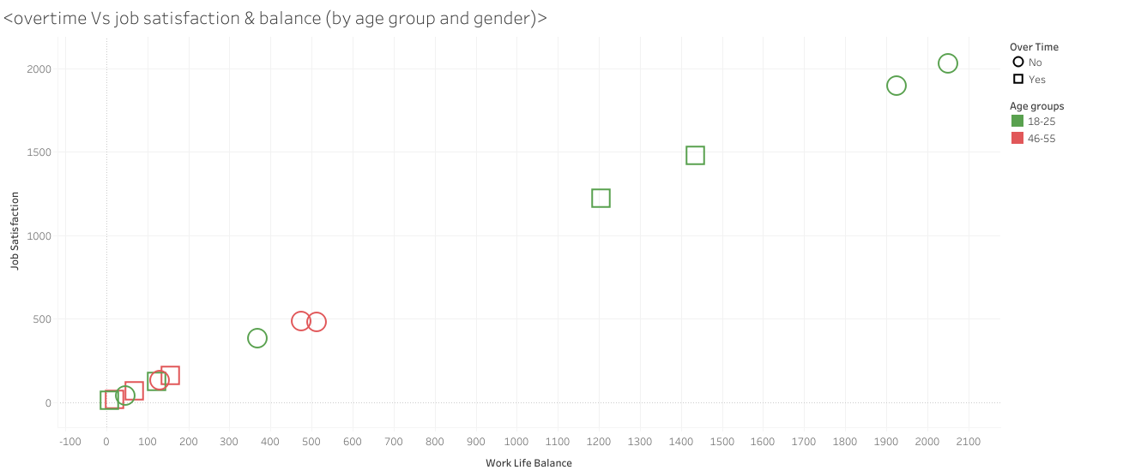
Older age groups show least job satisfaction

Slide 41
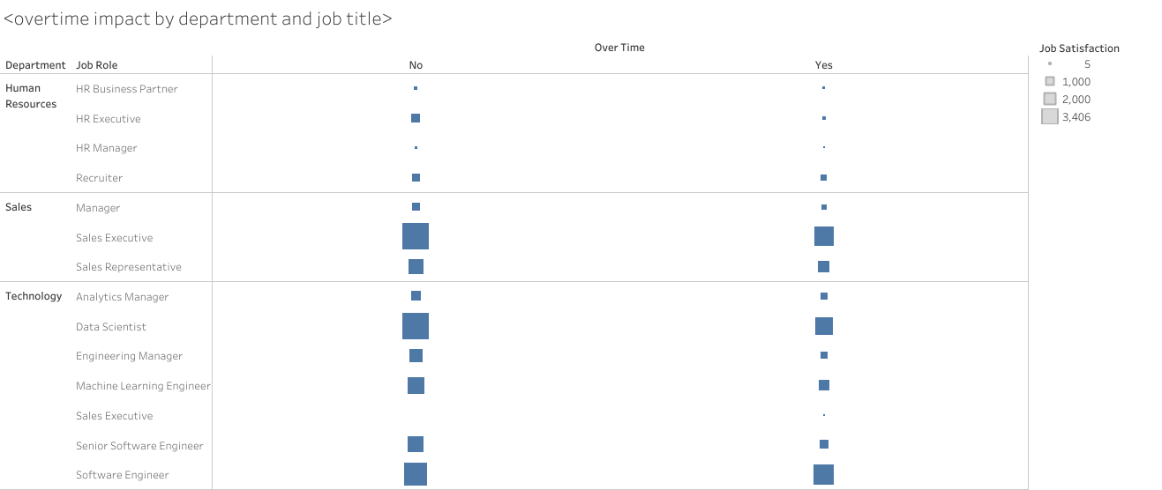
Overtime lower job satisfaction in all departments

Slide 42
Part 3: Manager Roles, Retention, and Loyalty
This part examines how demographic factors influence managerial roles and dives into the long-term metrics of retention and loyalty, including attrition rates, tenure, and promotions.

Slide 43
Manager Role and Retention Analysis

Slide 44
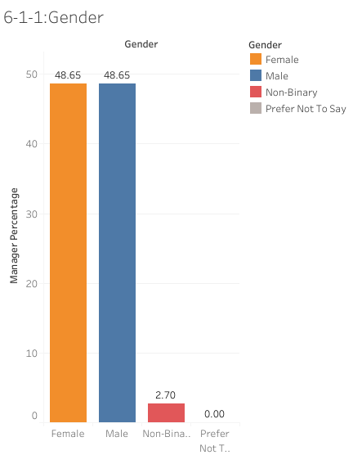
The percentage of male and female employees in managerial roles are in balances in leadership positions

Slide 45
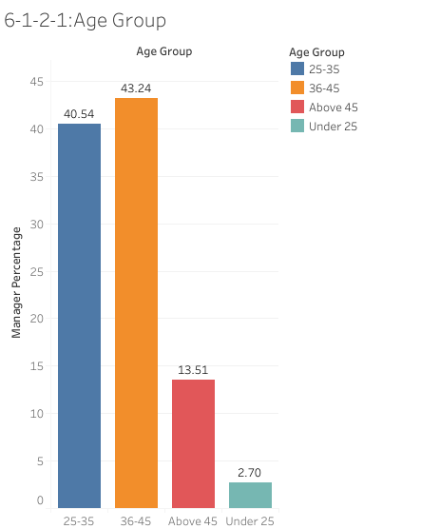
Different age groups compare in terms of percentage in managerial positions showing that employees with age range between 25 and 46 more likely to be in leadership roles

Slide 46
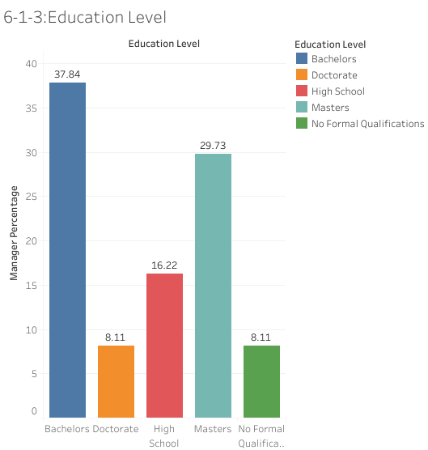
The percentage of employees with different education levels in managerial roles showing that employees with Bachelors and Masters are more likely to be in leadership roles

Slide 47
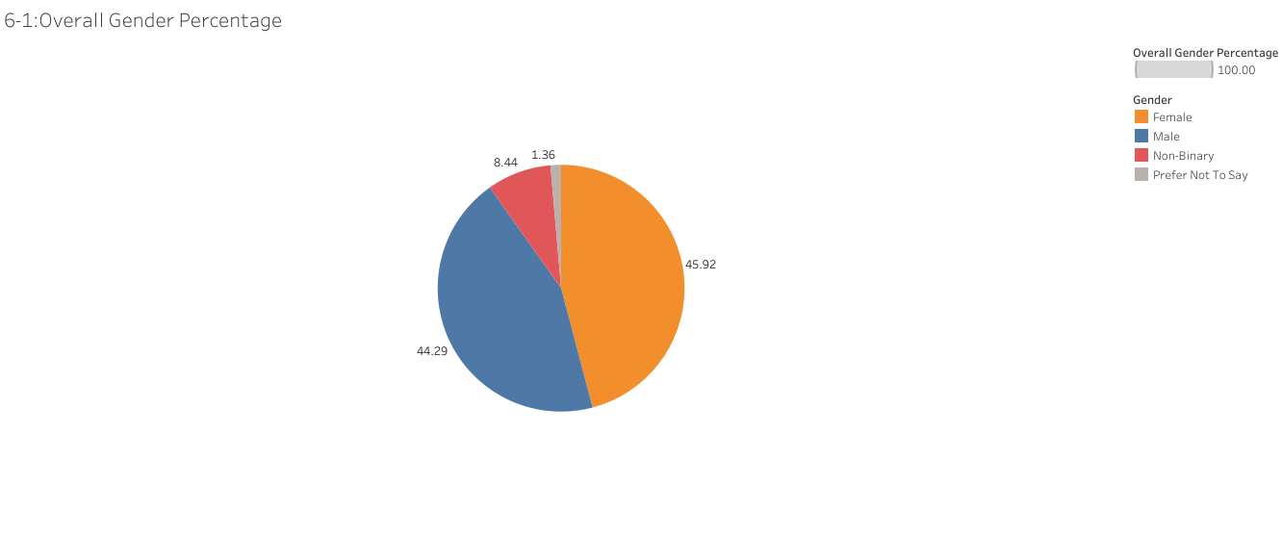
The percentage of employees according to Gender

Slide 48
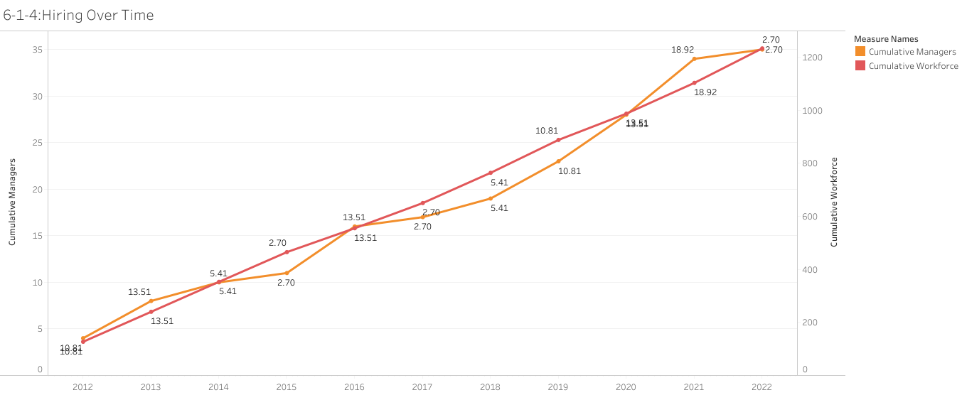
The trends in hiring over time, and how do the correlate with workforce development and managerial growth

Slide 49
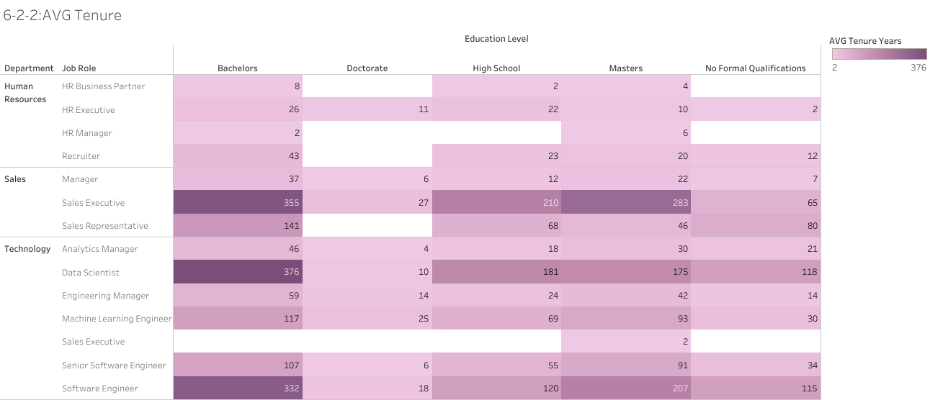
How long employees stay with the company, according to Department, Job Role, and Education Level

Slide 50
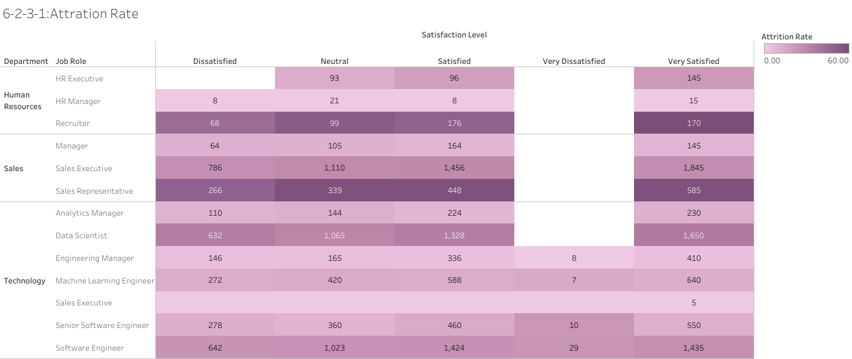
Calculate attrition rates by Department, Role, and Job Satisfaction. Showing employees with higher satisfaction less likely to leave

Slide 51
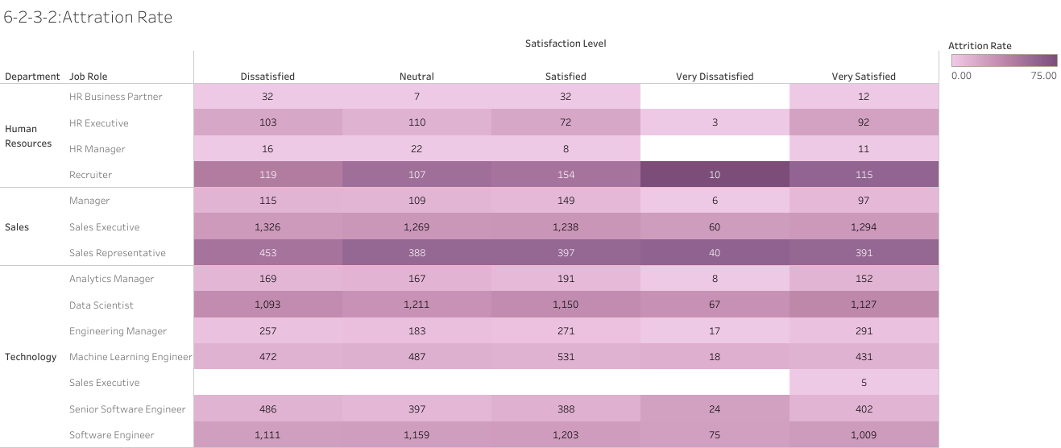
Calculate attrition rates by Department, Role, and work-life balance. Showing employees with higher satisfaction less likely to leave

Slide 52
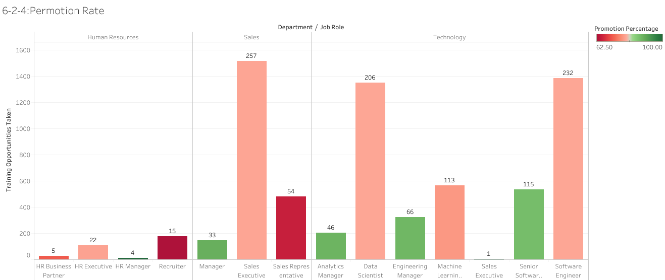
Track promotion rates by Department and Job Role, showing whether training opportunities correlate with faster promotions.

Slide 53
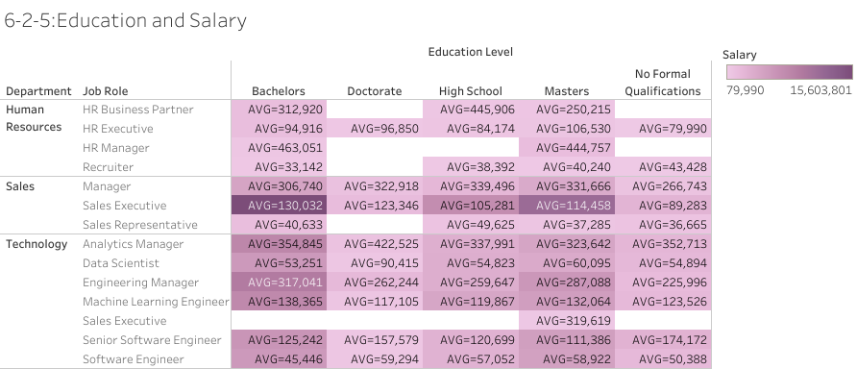
Employees with higher education levels receive higher salaries, showing how does this compare across Job Role & Department

Slide 54
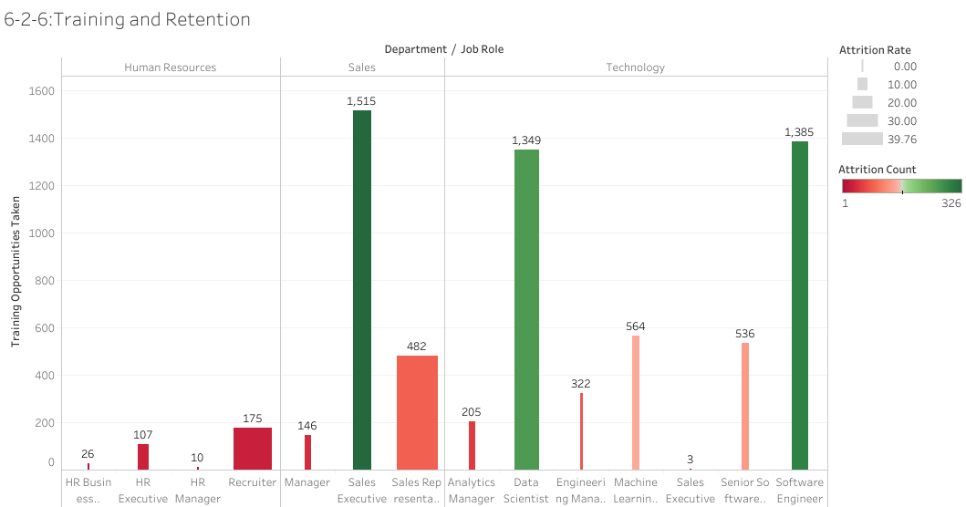
Assess whether providing training opportunities improves employee loyalty.

Slide 55
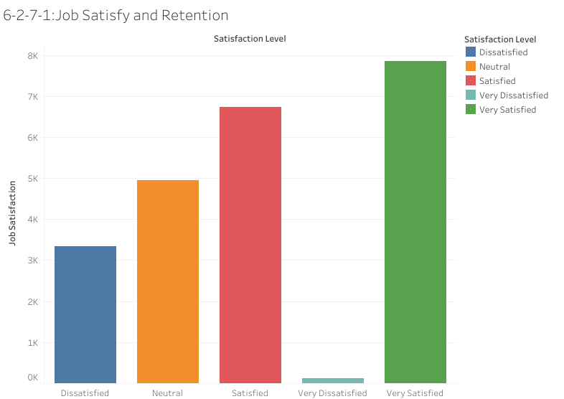
Employees with higher job satisfaction stay longer in the company

Slide 56
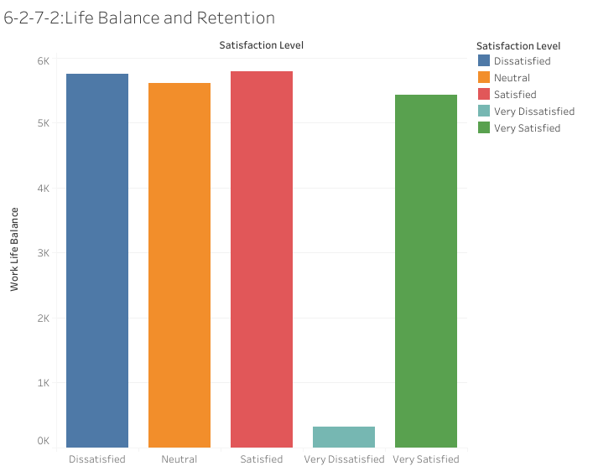
Employees with better work-life balance stay longer in the company

Slide 57
Dashboard
The next slides show the dashboard which contains the sample charts of each part as a conclusion

Slide 58
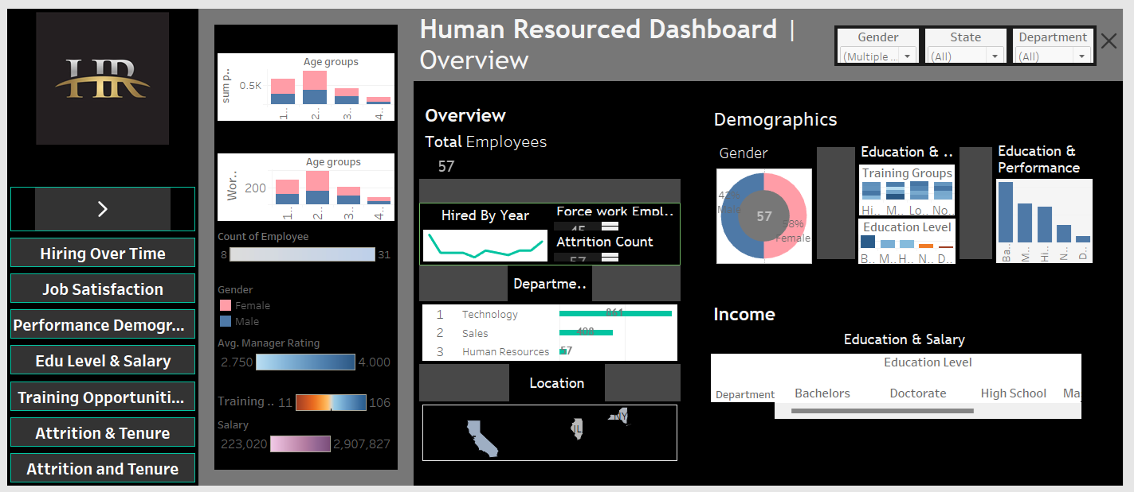

Slide 59
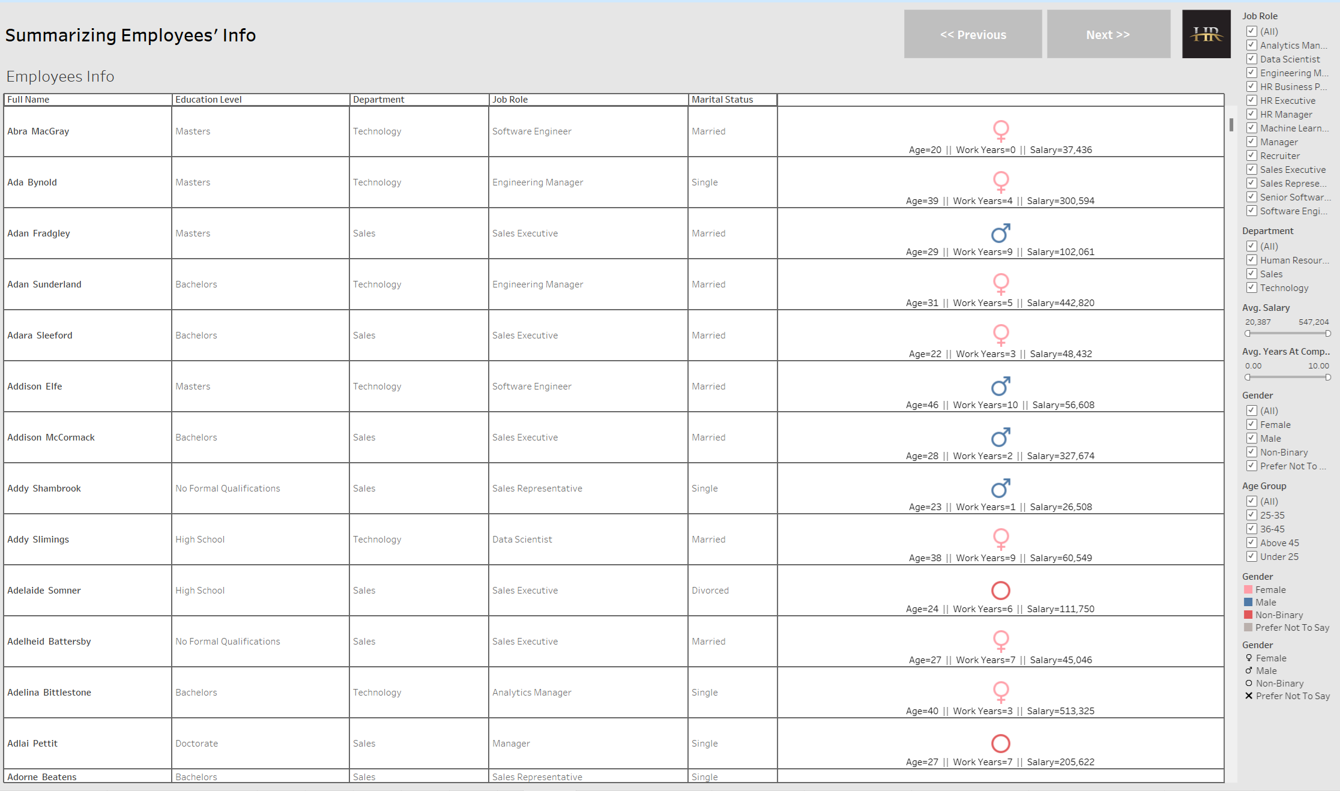
Summarizing employee Info

Slide 60

The Demographic Patterns in Managerial Roles (Gender, Age Group, Education Level)

Slide 61

Hiring Over Time (Gender, Workforce, Managerial growth)

Slide 62

Attrition and Tenure (Education Level, Job Satisfaction, work-life balance)

Slide 63

Training Opportunities (Improves Employee's Loyalty, Faster Promotions)

Slide 64

Training Opportunities (Improves Employee's Loyalty, Faster Promotions)

Slide 65

Job Satisfaction(Education Level, Training Opportunities, Department, Job Role)

